Slide 1

Advanced spreadsheets
Lesson 3: Macros

Slide 2
Objectives
In this lesson, you will learn how to:
record macros to automate aspects of a spreadsheet
assign macros to a button
view the code recorded by a macro.

Slide 3

Robots

Slide 4
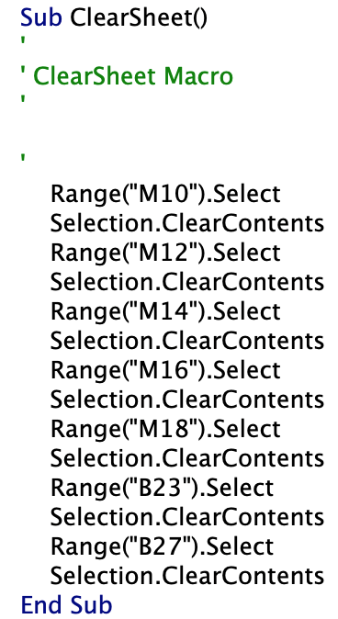
Macros
Macros are small programs that record your mouse clicks and key strokes as you complete a task.
In Excel, the actions are saved as Visual Basic code, that can be viewed and edited if necessary.

Slide 5
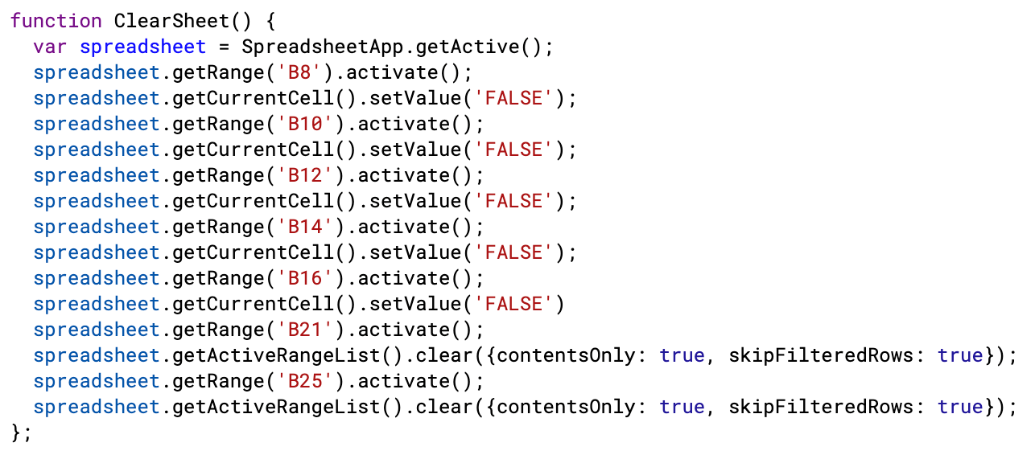
Macros
Macros are small programs that record your mouse clicks and key strokes as you complete a task.
In Google Sheets, the actions are saved as JavaScript code, that can be viewed and edited if necessary.

Slide 6
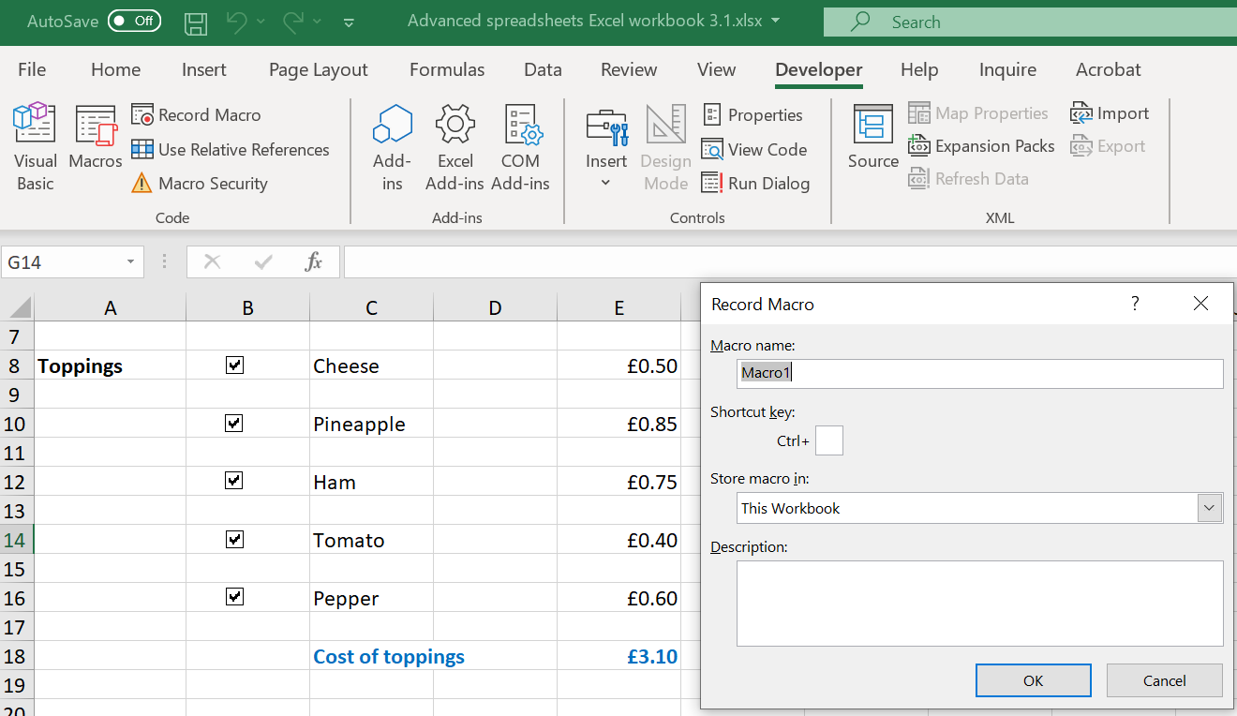
Recording macros
Before recording a macro in Excel, you should re-save your spreadsheet as a macro-enabled spreadsheet.
You will need to give your macro a name before the recording begins
When you have finished recording your macro, it will automatically save to the spreadsheet.
Now watch Video 3.1 (Excel)

Slide 7
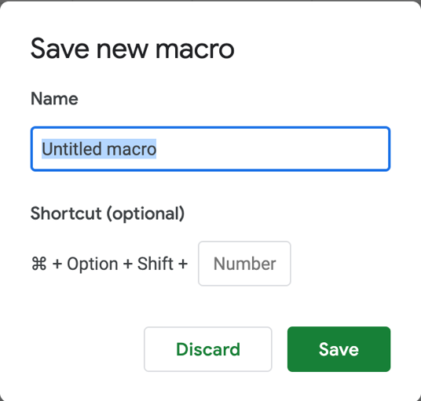
Recording macros
To record a macro in Google Sheets, select ‘Tools’, ‘Macros’ and ‘Record macro’. The recording will begin immediately.
When you have finished recording your macro, give it a name and it will automatically save to the spreadsheet.
Now watch Video 3.1 (Google Sheets)

Slide 8
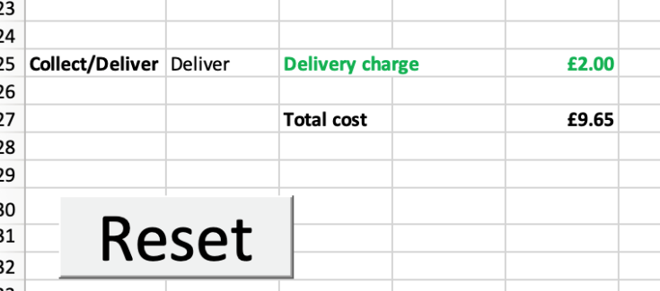
Assigning macros
Once a macro has been recorded it can be assigned to a button.
A button is inserted from the ‘Form Control’ menu.
The macro is assigned by right-clicking on the button, choosing ‘Assign macro’ and selecting the macro required.
When the macro is run it will repeat the mouse clicks and key strokes you recorded.
Now watch Video 3.2 (Excel)

Slide 9
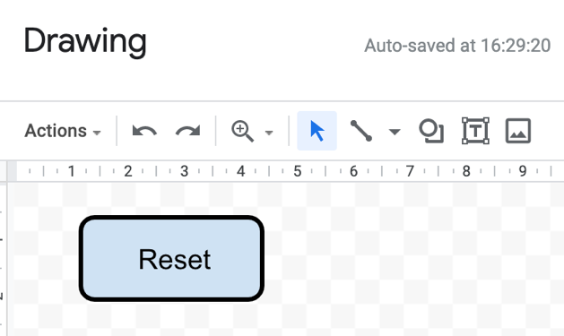
Assigning macros
Once a macro has been recorded, it can be assigned to a button.
Go to ‘Insert’ and select ‘Drawing’ and create a suitable shape for your button. Click on ‘Save and close’ to add it to your spreadsheet and reposition it by selecting and dragging it.
Assign a macro to the button by selecting the button, clicking on the three dots, choosing ‘Assign a script’, typing in the macro name and pressing ‘OK’.
When the macro is run it will repeat the mouse clicks and key strokes you recorded. The first time you try to run a macro you will be asked for authorisation to run the script.
Now watch
Video 3.2 (Google Sheets)

Slide 10

Activity 3.1: Pizza orders (Part 3, Excel)
You have created a spreadsheet to calculate the cost of a pizza order, but the values entered need to be cleared before the next order can be input. It is possible to automate this process using a macro.
Record a macro to reset the spreadsheet ready for the next order. You will need to clear the contents of the cells in column M linked to the check boxes, and also clear the contents of the two cells in column B containing values selected from drop-down lists.
To clear these values, you simply need to right click on each relevant cell and select ‘Clear contents’.
Insert a button and give it a suitable name.
Assign your macro to the button and test it to check that it resets the spreadsheet correctly.

Slide 11
Activity 3.1: Pizza orders (Part 3, Google)
You have created a spreadsheet to calculate the cost of a pizza order, but the values entered need to be cleared before the next order can be input. It is possible to automate this process using a macro.
Record a macro to reset the spreadsheet ready for the next order. You will need to unselect the check boxes and clear the contents of the two cells in column B containing values selected from drop-down lists.
Draw a button, give it a suitable name and insert it into the spreadsheet.
Assign your macro to the button and test it to check that it resets the spreadsheet correctly.

Slide 12
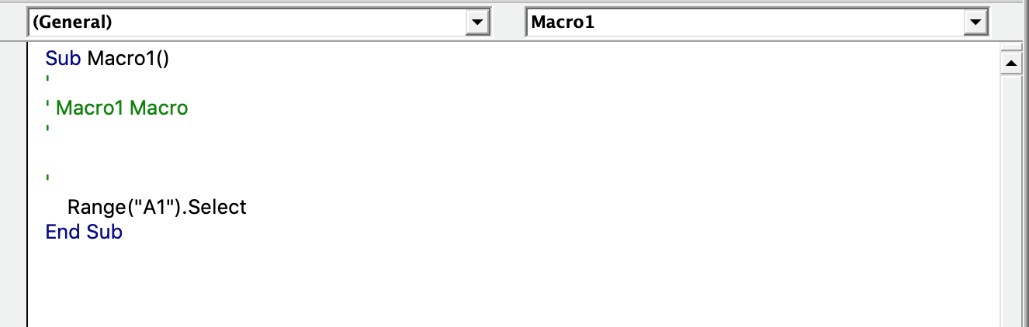
Editing a macro
Once a macro has been recorded, you can edit the Visual Basic code to correct errors or to add extra functionality.
Click on ‘View Macros’ and select ‘Edit’ to see the code.
The code can be edited by typing directly into the code window.

Slide 13
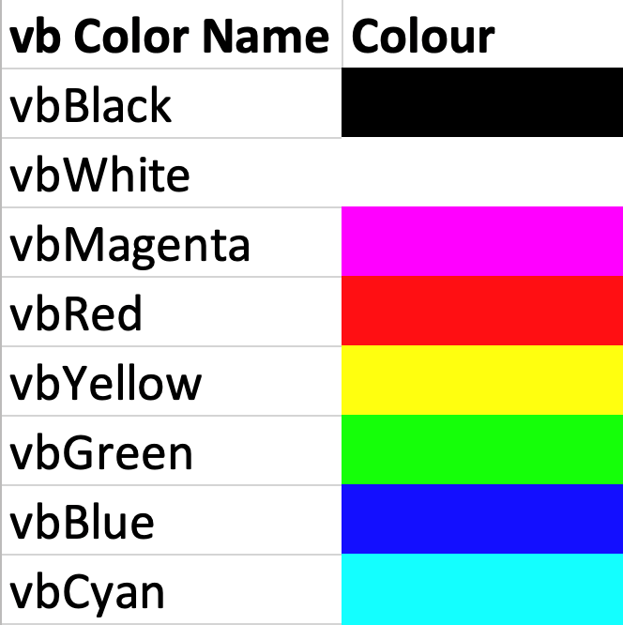
Changing the text colour
It is possible to change the text colour of a specific cell in Excel by selecting it and then setting the colour.
Range("A1").Font.Color = vbGreen
Here, the cell A1 has been selected and the font colour has been changed to green using vbGreen.
This is the easiest way to change the text colour, but the options are limited:

Slide 14
Other vb formatting commands
Here are some examples of other vb formatting commands in Excel.
Set the cell background colour to yellow:
Range("A1").Interior.Color = vbYellow
Change the font to Courier:
Range("A1").Font.Name = "Courier”
Change the font size to 16 point:
Range("A1").Font.Size = 16
Set the font to bold using a Boolean value of True:
Range("A1").Font.Bold = True
Now watch
Video 3.3 (Excel)

Slide 15
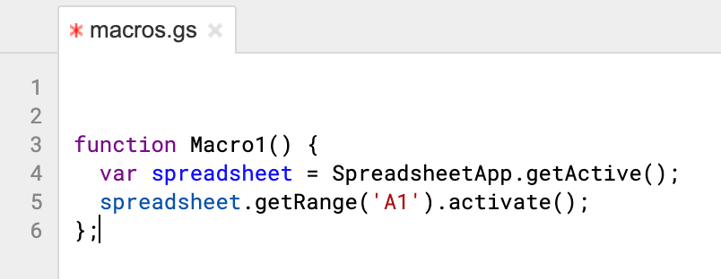
Editing a macro
Once a macro has been recorded, you can edit the JavaScript code to correct errors or add extra functionality.
Click on ‘Tools’ and select ‘Script editor’ to see the code.
The code will open up in a separate browser window and can be edited by typing directly into the code window.
Remember to save the code when you have finished editing it.

Slide 16
Changing the text colour
It is possible to change the text colour of a specific cell in Google Sheets by selecting it and then setting the colour.
spreadsheet.getRange(‘A1’).activate();
spreadsheet.getActiveRangeList().setFontColor (‘green’);
Here, the cell, A1, has been selected and the font colour has been changed to green using the colour name.
Using a predefined colour name is the easiest way to change the colour. A full list of colour names can be found online.

Slide 17
Other JavaScript formatting commands
Here are some other examples of other JS formatting commands in Google Sheets.
Set the text colour to blue:
spreadsheet.getActiveRangeList().setFontColor(‘blue’);
Set the cell background colour to yellow:
spreadsheet.getActiveRangeList().setBackground(‘yellow’);
Change the font to Courier:
spreadsheet.getActiveRangeList().setFontFamily(‘Courier’);
Change the font size to 16 point:
spreadsheet.getActiveRangeList().setFontSize(16);
Set the font to bold:
spreadsheet.getActiveRangeList().setFontWeight(‘bold’);
Now watch Video 3.3 (Google Sheets)

Slide 18
Activity 3.2: Editing macros

Slide 19
Quiz 3

